Slide 1
IBM HR ANALYTICS
EMPLOYEE ATTRITION
Kaixin Yang

Slide 2
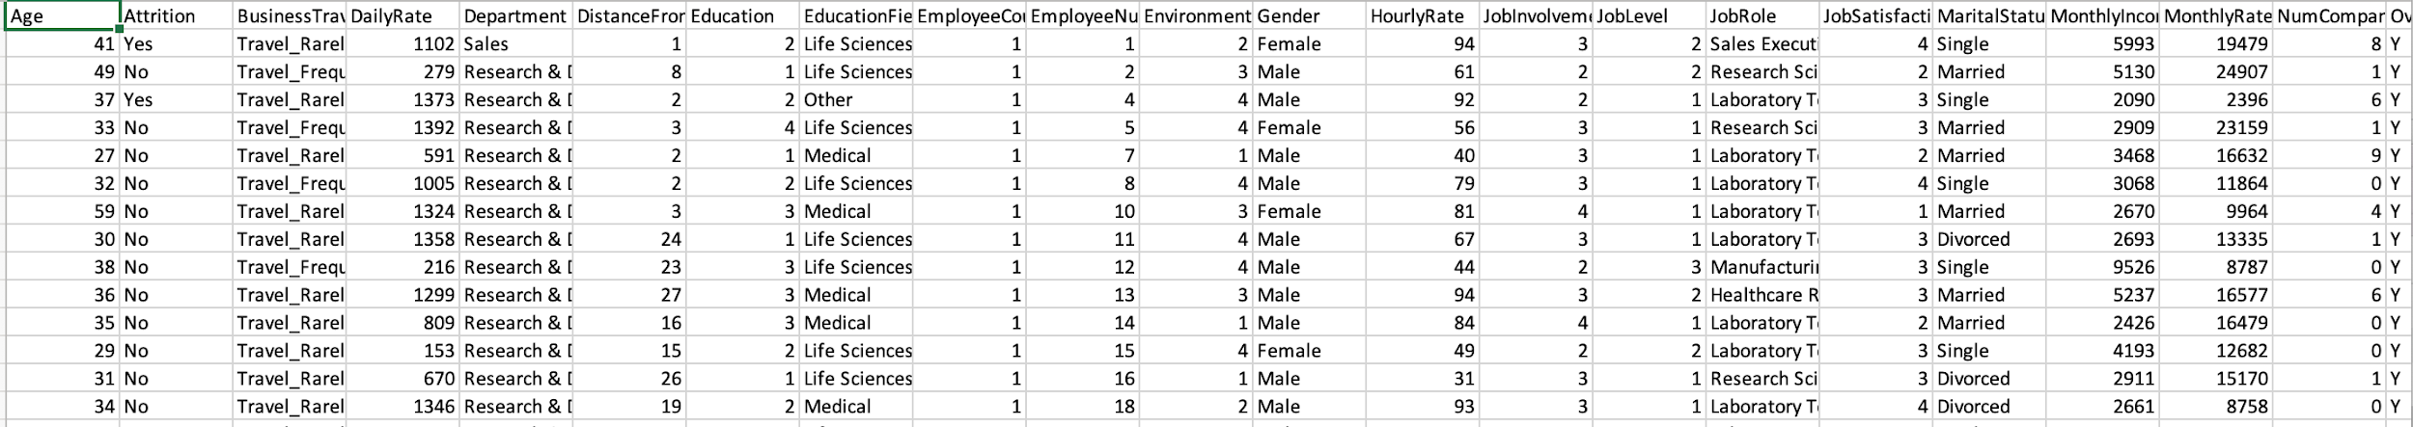
DATA SOURCES
Kaggle:
https://www.kaggle.com/datasets/rishikeshkonapure/hr-analytics-prediction
Data of demographic , survey answers , and attrition.
35 columns, 1470 rows.
9 categorical features, 26 numerical features.

Slide 3
BUSINESS QUESTION
What factors contribute to employee attrition?
Can we predict the attrition rate?
Poor work-life balance
Not enough career opportunities
Poor job satisfaction and pay
EXIT

Slide 4
WHY THIS TOPIC?
Attrition rate directly impacts company’s productivity, financial health, and competitiveness.
Help companies make data-driven decisions to improve their organizational effectiveness and performance.
HR departments can develop targeted retention strategies to reduce attrition rates and improve employee satisfaction and engagement.

Slide 5
TABLE OF CONTENTS
1.DATA PREPROCESSING
2. EXPLORATORY ANALYSIS
3. DATA PREPARATION
Data cleansing & Formatting
Missing values & Drop Columns
Selecting features
Categorical features
Numerical features
Correlation analysis ( Heat Map)
Feature selection
Label encoding
Addressing imbalance data
4.MODEL
5. SHARE IDEAS
Data Modeling with SMOTE Hyperparameter tuning
Model Evaluation
Tableau Dashboard
Recommendations
Slides & Report

Slide 6
DATA CLEANSING
Missing values
No missing/null values and duplicates in this dataset.
Drop useless features
Removed 'Over18', 'EmployeeCount', and 'StandardHours' due to their singular unique values. Also excluded 'EmployeeNumber' as it doesn't significantly influence the analysis results.
Encode the attrition column

Slide 7

EXPLORATORY ANALYSIS

Slide 8
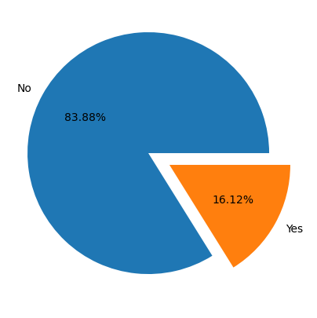
EDA
16.12% of employees left their job
The dataset is imbalance, so two strategies are implemented:
Resampling Techniques: Oversampling and undersampling using SMOTE.
Choosing the Appropriate Evaluation Metric

Slide 9
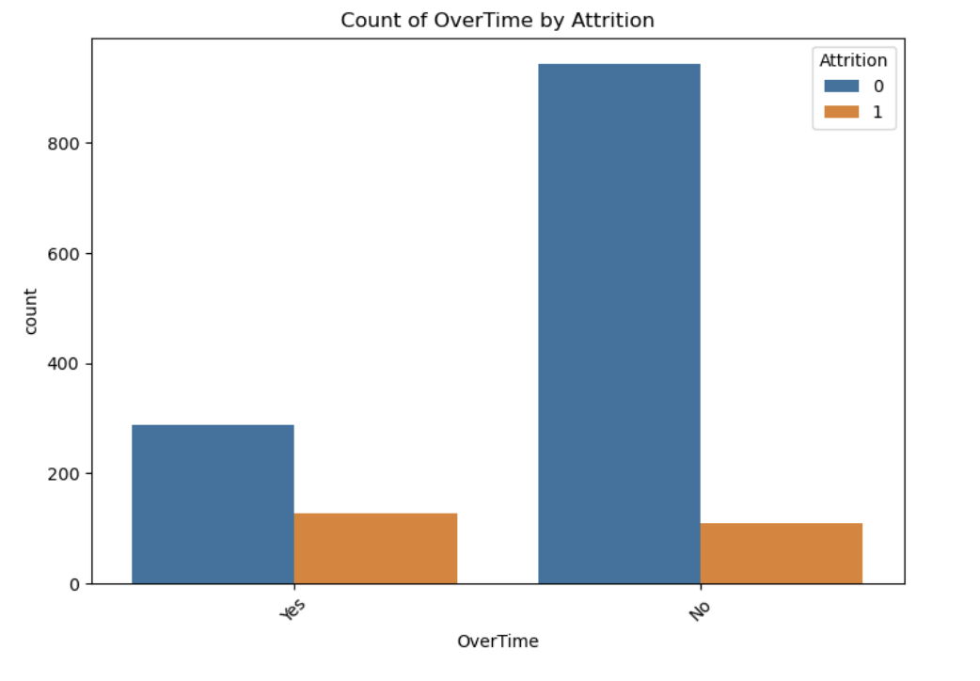
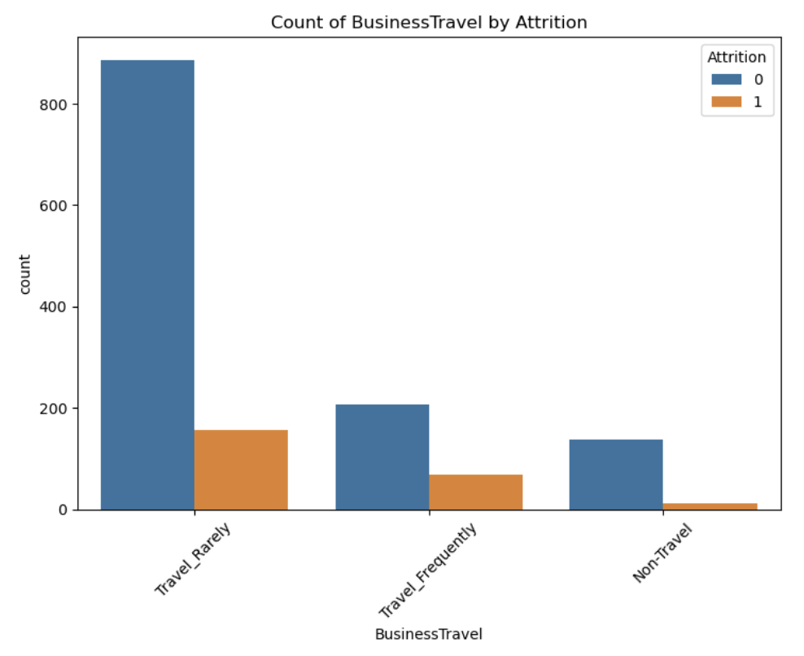
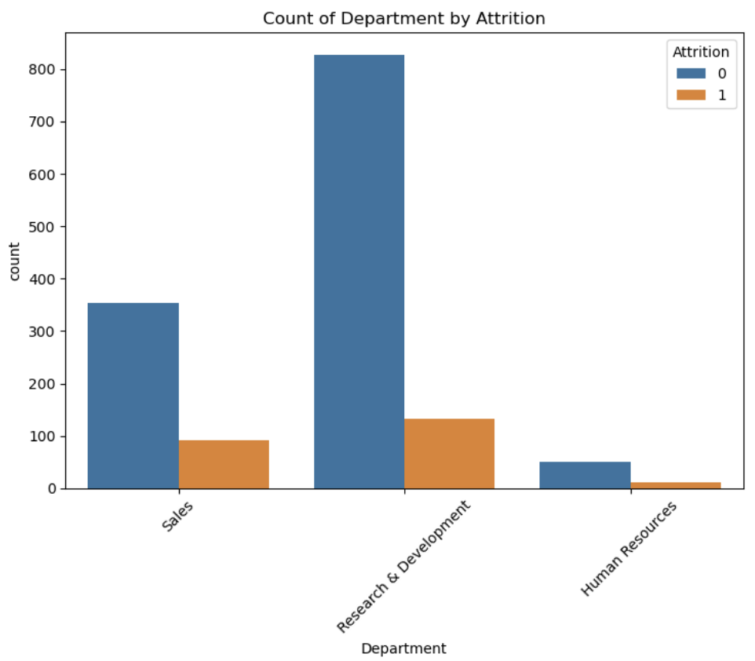
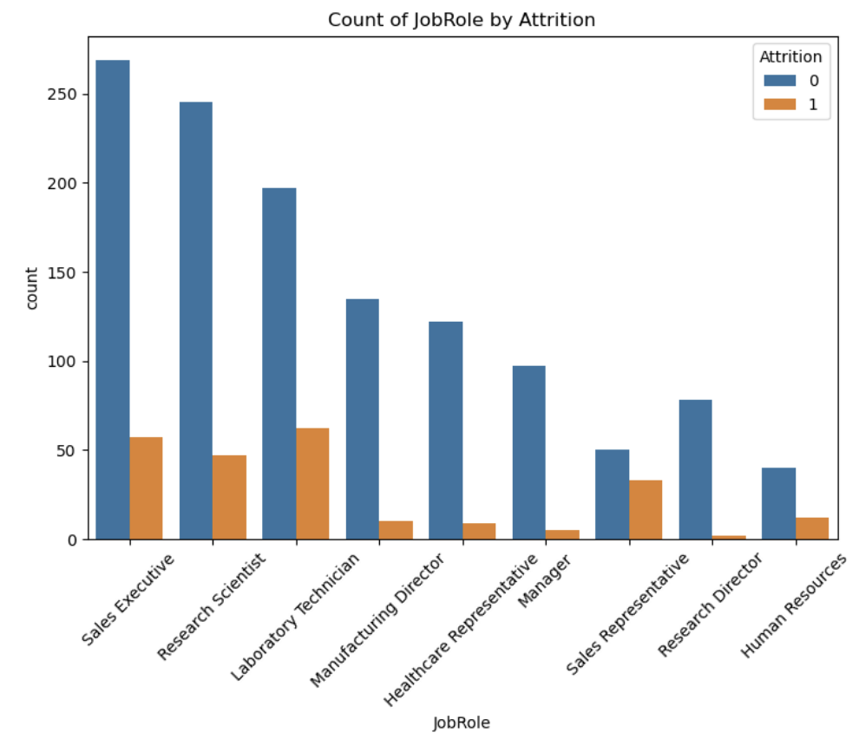
CATEGORICAL FEATURES

Slide 10
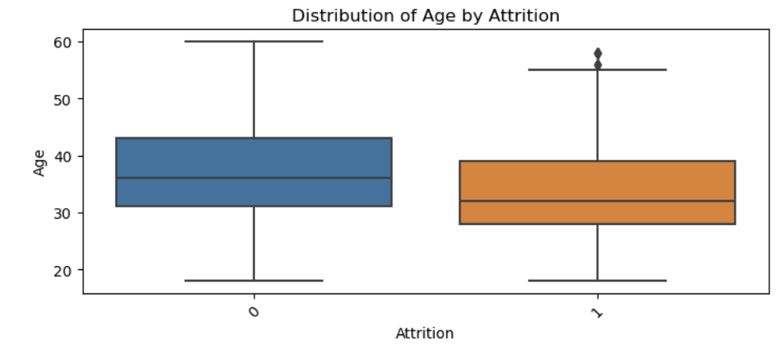
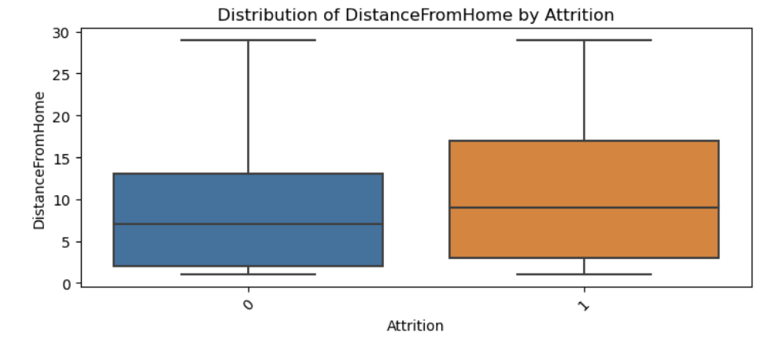
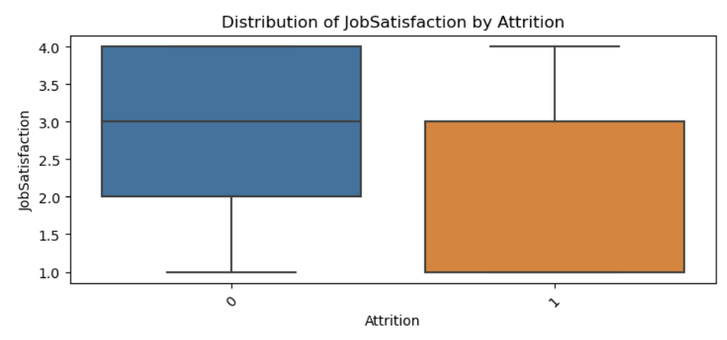
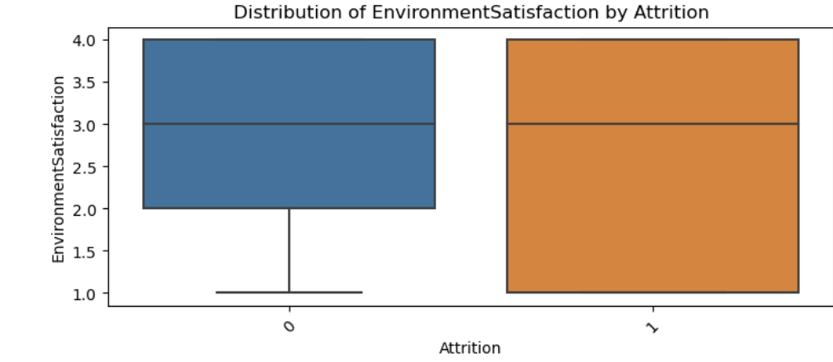
NUMERICAL FEATURES

Slide 11
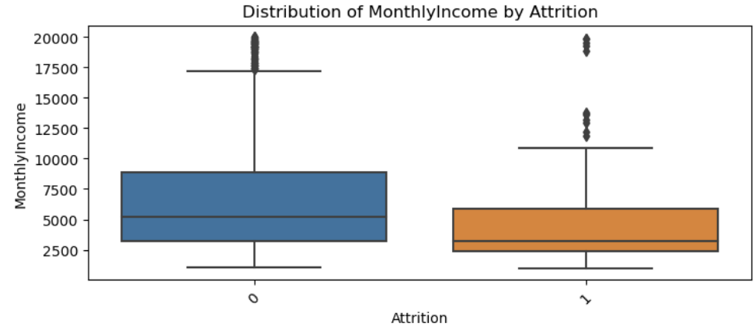
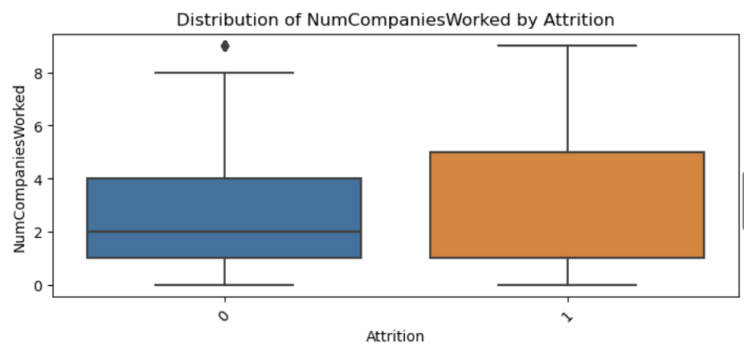
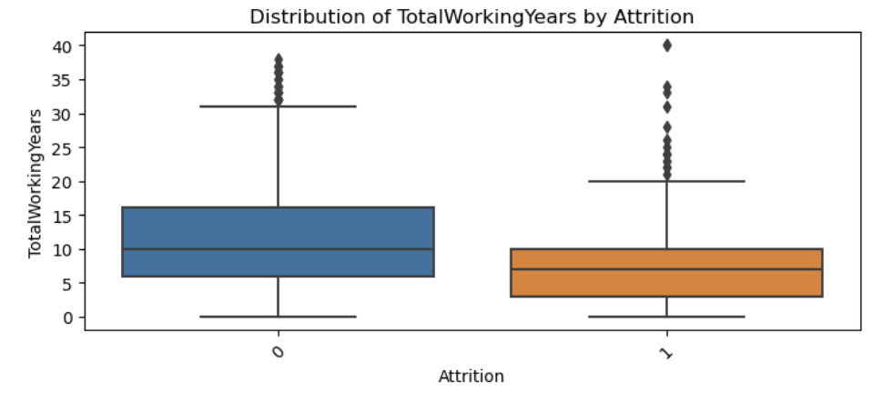
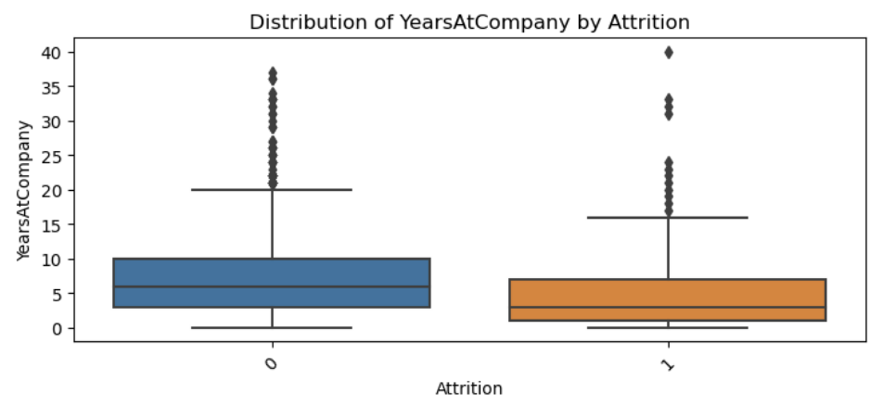
NUMERICAL FEATURES

Slide 12
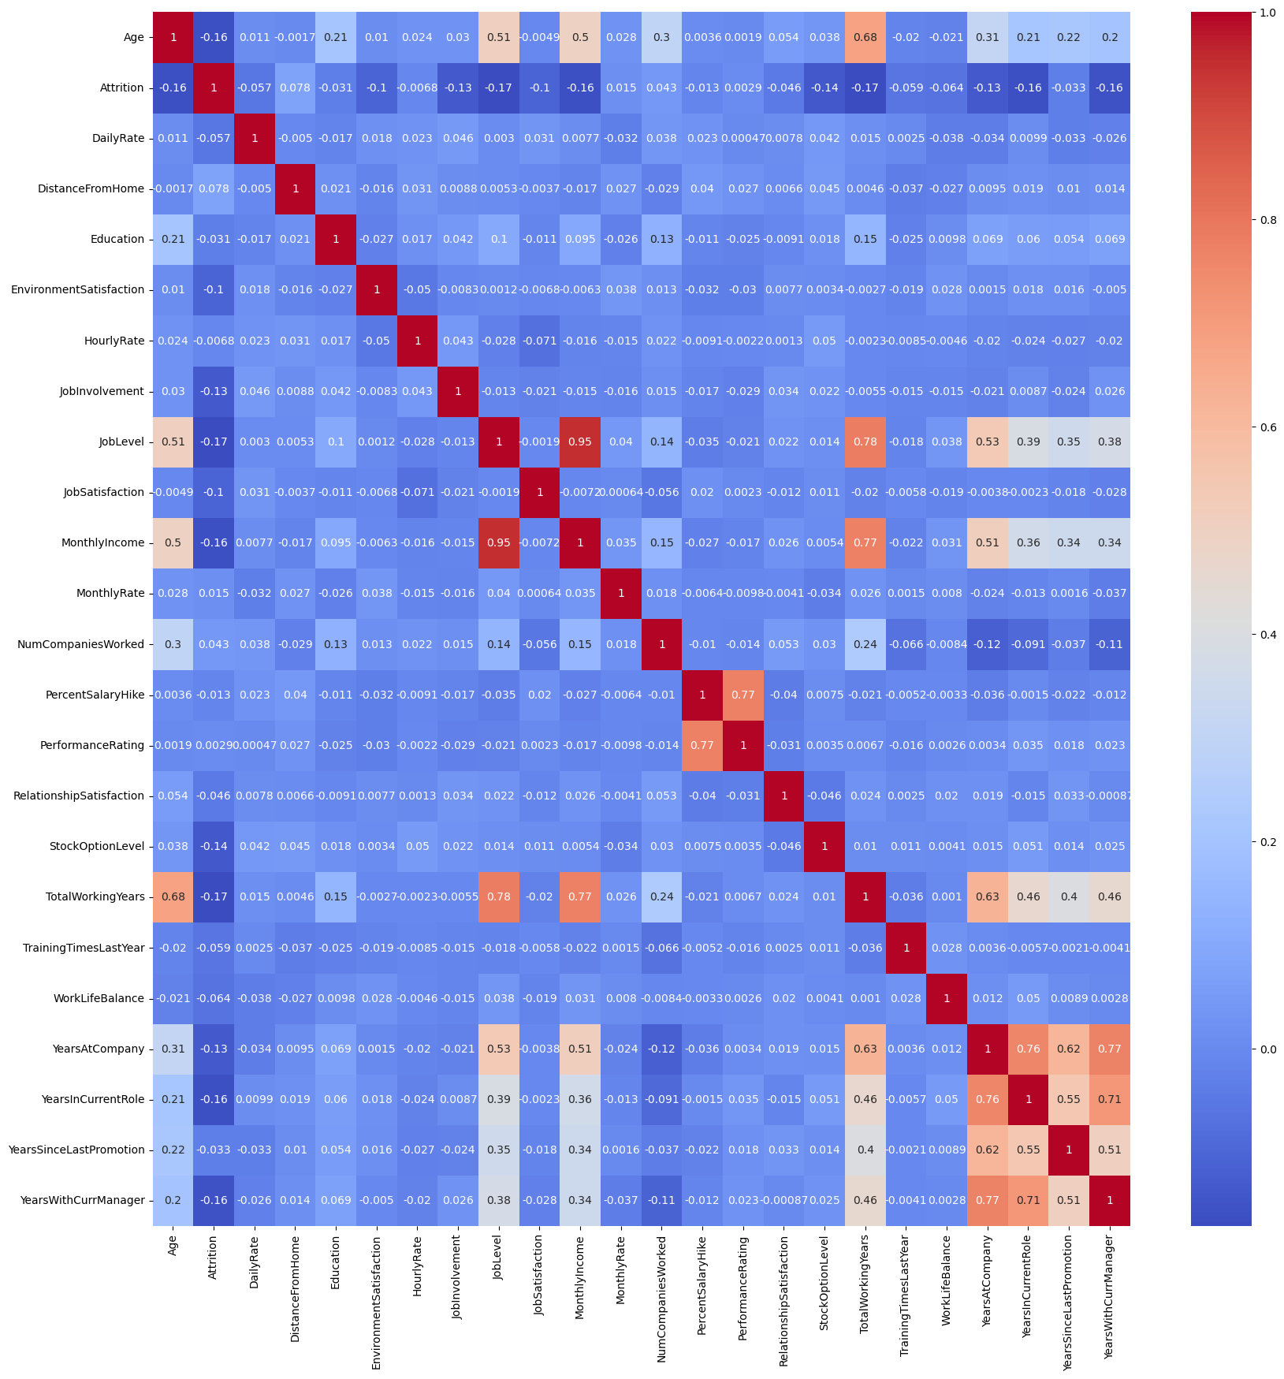
CORRELATION MATRIX
Strong correlations found: "JobLevel" with both "TotalWorkingYears" and "MonthlyIncome".
Younger employees and those with less experience have higher attrition rates.
Longer tenure in various roles reduces attrition risk.
Distance from home and multiple past employers increase attrition likelihood.
Etc…

Slide 13
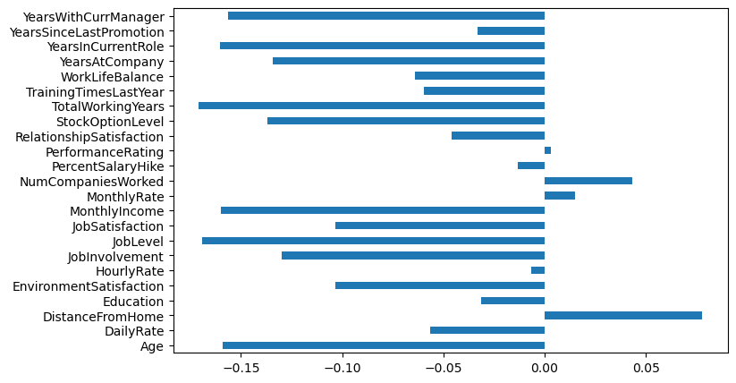
CORRELATION BETWEEN ATTRIBUTES AND ATTRITION

Slide 14
FEATURE SELECTION
The selection of variables is refined based on the following criteria:
1.Type of Variable.
2.Variability in Data Points.(Employee Count,Over18,StandardHours)
3.Independence between the Target and Independent Variables.
Based on the correlation heat map and the result of Chi-Square Test, I decide to drop:
'DailyRate', 'DistanceFromHome', 'Education', 'Gender', 'HourlyRate', 'MonthlyRate', 'PercentSalaryHike', 'PerformanceRating', 'RelationshipSatisfaction', 'YearsSinceLastPromotion'
4.Multicollinearity.
'JobLevel' has a high correlation with 'MonthlyIncome' and 'TotalWorkingYears'.
'TotalWorkingYears' has a high correlation with 'JobLevel' and 'MonthlyIncome'.

Slide 15



MODELING

Slide 16
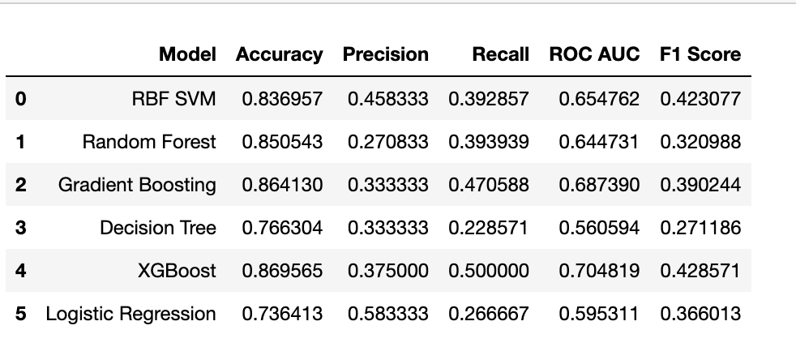
BUILDING THE MODEL
& MAKING PREDICTION WITH SMOTE

Slide 17
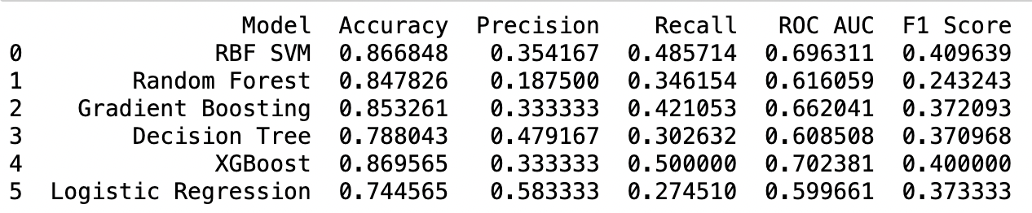
ENHANCE MODEL PERFORMANCE THROUGH HYPERPARAMETER TUNING
Among various models, "XGBoost" emerges as the most balanced choice with notable accuracy, recall, and ROC AUC scores, while "Logistic Regression" offers the highest precision.

Slide 18
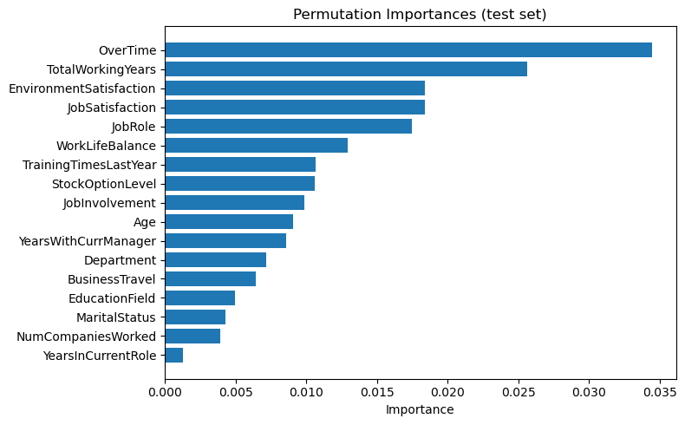
FEATURE IMPORTANCE

Slide 19

DASHBOARD

Slide 20
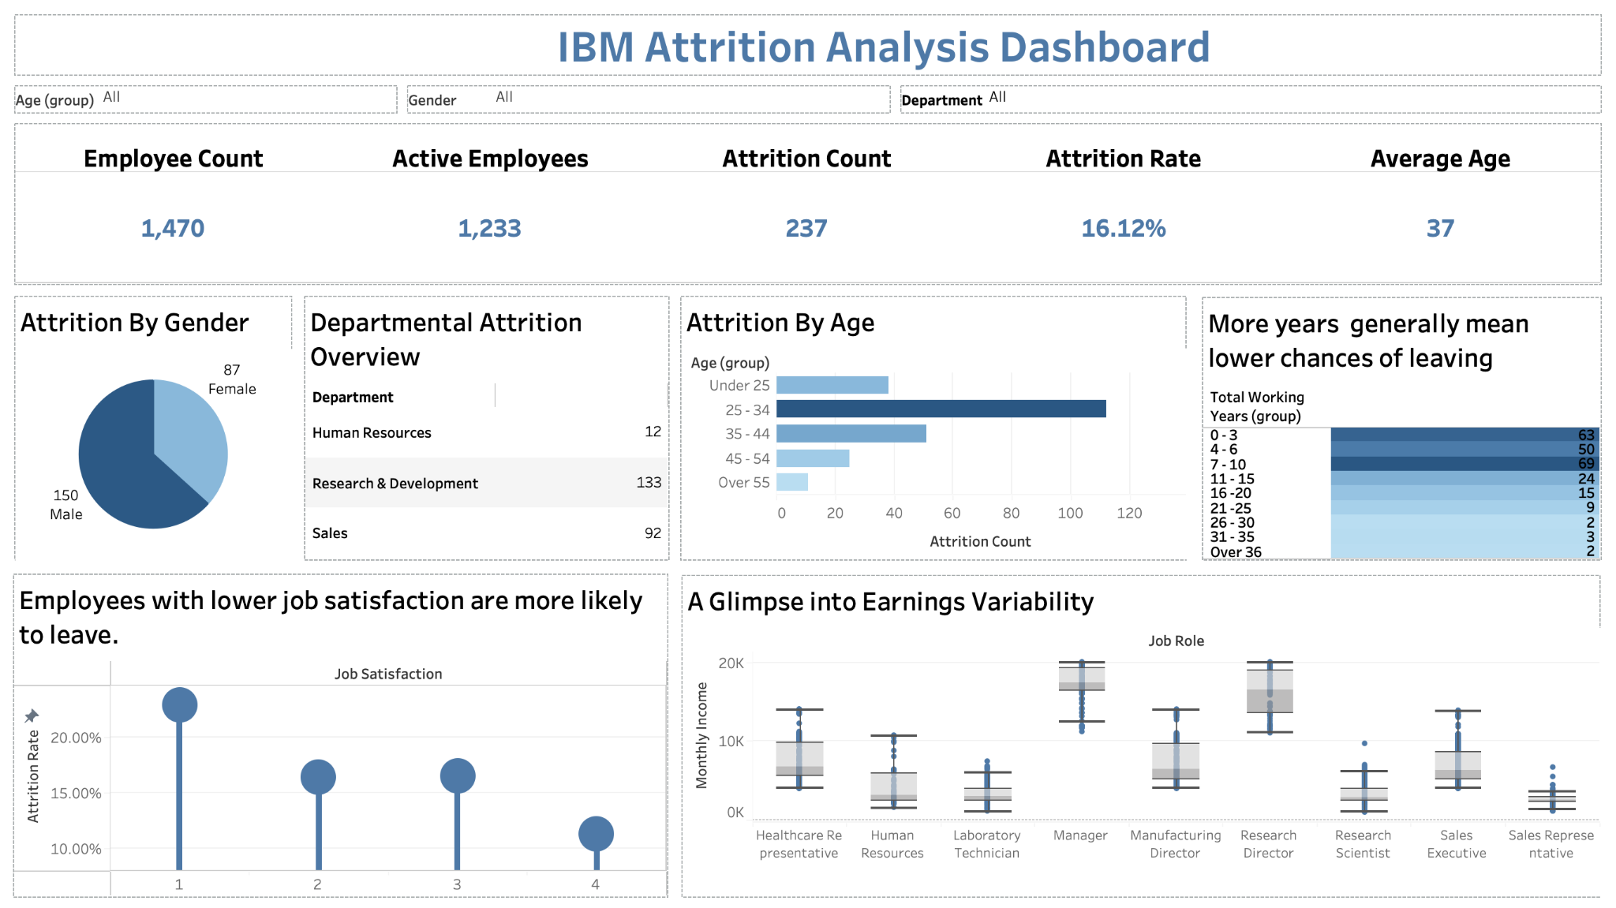

Slide 21

OBSERVATIONS
Based on the analysis of the dataset, 16.1% of employees left their job.
Frequent overtime may lead to employee burnout and higher attrition.
Longer working years might indicate career stagnation or a desire for change.
Specific roles may be stressful, and overall job dissatisfaction can lead to attrition.
Employees seeking better work-life balance might consider changing jobs.
Inconsistent training can either overwhelm or make employees feel neglected.
In average, Manager and Research Director have highest Monthly Income. While the groups with lower income like Lab Technician may lead higher attribution rates.
Better stock options can retain employees, and their connection to their role affects retention.
Longer tenure with a manager or age might spur a desire for change.
Departments, travel frequency, education, and marital status can subtly influence retention decisions.

Slide 22
RECOMMENDATIONS FOR
EMPLOYEE ENGAGEMENT & RETENTION
OverTime: Introduce flexible hours and overtime compensation. Check well-being for extended workers.
Tenure: Encourage career growth; host "career exploration" events.
Environment: Collect feedback; establish environment committees.
Role Satisfaction: Conduct satisfaction checks; promote job rotation.
Work-Life: Cultivate balance; offer remote/flexi-hours.
Training: Tailor training; align with role relevance.
Benefits & Engagement: Optimize stock plans; reinforce company mission.
Experience & Leadership: Offer mentorship; diversify managerial experiences.
Personal Preferences: Regulate travel; promote department collaboration; host tailored workshops.

Slide 23
EXTERNAL SUPPORTING MATERIALS
Calculating and improving your attrition rate: Metrics that matter
Employee Attrition Prediction - A Comprehensive Guide - Analytics Vidhya
Attrition - Overview, Types, How To Calculate, Importance

Slide 24
THANK
YOU

